Slide 1
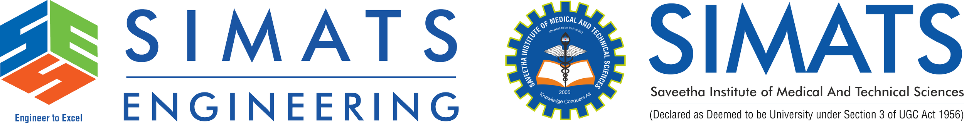
ITA0506-Computer Vision
Computer Vision applications
Guided BY
Dr.R.C.Jeni Gracia
By
G.D.S.P.Santosh Raja (192425064)
T.V.SAI JAGADEESH (192472146)
C.Chandu (192472332)
Y.Sravan Kumar (19242289)
Y.Tejanvesh Reddy (192425156)
B.Rakesh (192425241)

Slide 2


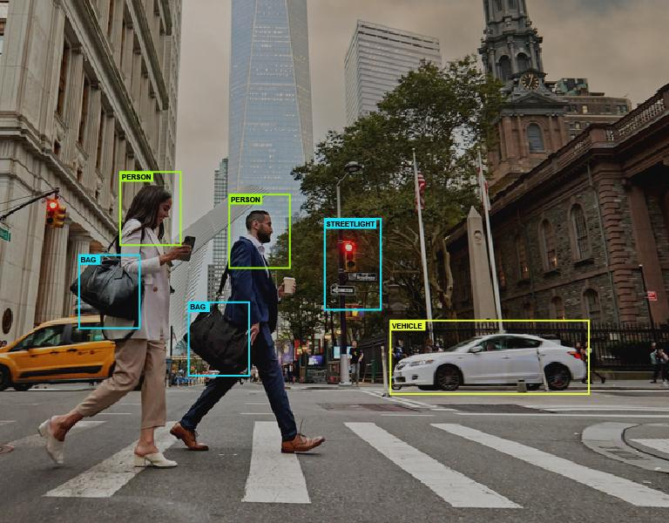
Introduction
Computer Vision is a branch of Artificial Intelligence (AI).
It enables computers to understand and analyze images and videos.
It uses cameras and image-processing techniques to collect visual information.
Machine Learning and Deep Learning improve recognition accuracy.
It can identify objects, faces, patterns, text and activities.
Computer Vision is used in healthcare, transportation, security and industries.

Slide 3
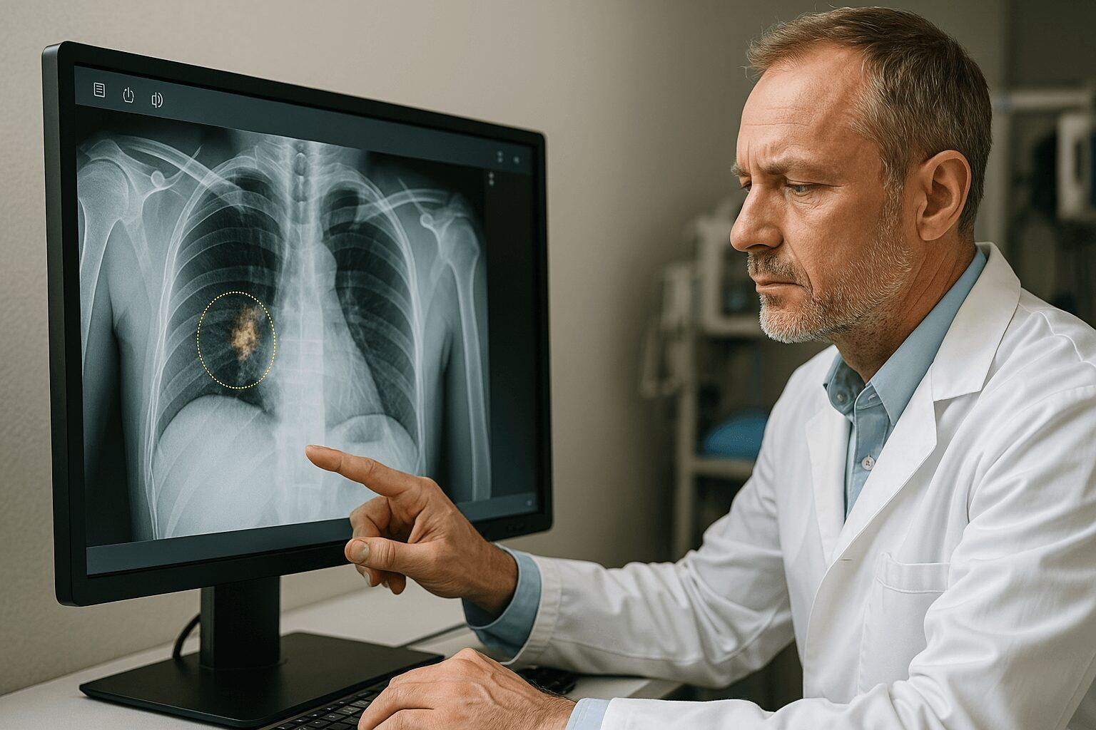
Compute vision in healthcare
Computer Vision helps doctors analyze medical images.
It can process X-rays, CT scans, MRI scans and ultrasound images.
It helps identify tumors, fractures and other abnormalities.
AI-based systems can assist in early disease detection.
It reduces the time required for analyzing large numbers of medical images.
Computer Vision can support doctors in diagnosis and treatment planning.

Slide 4
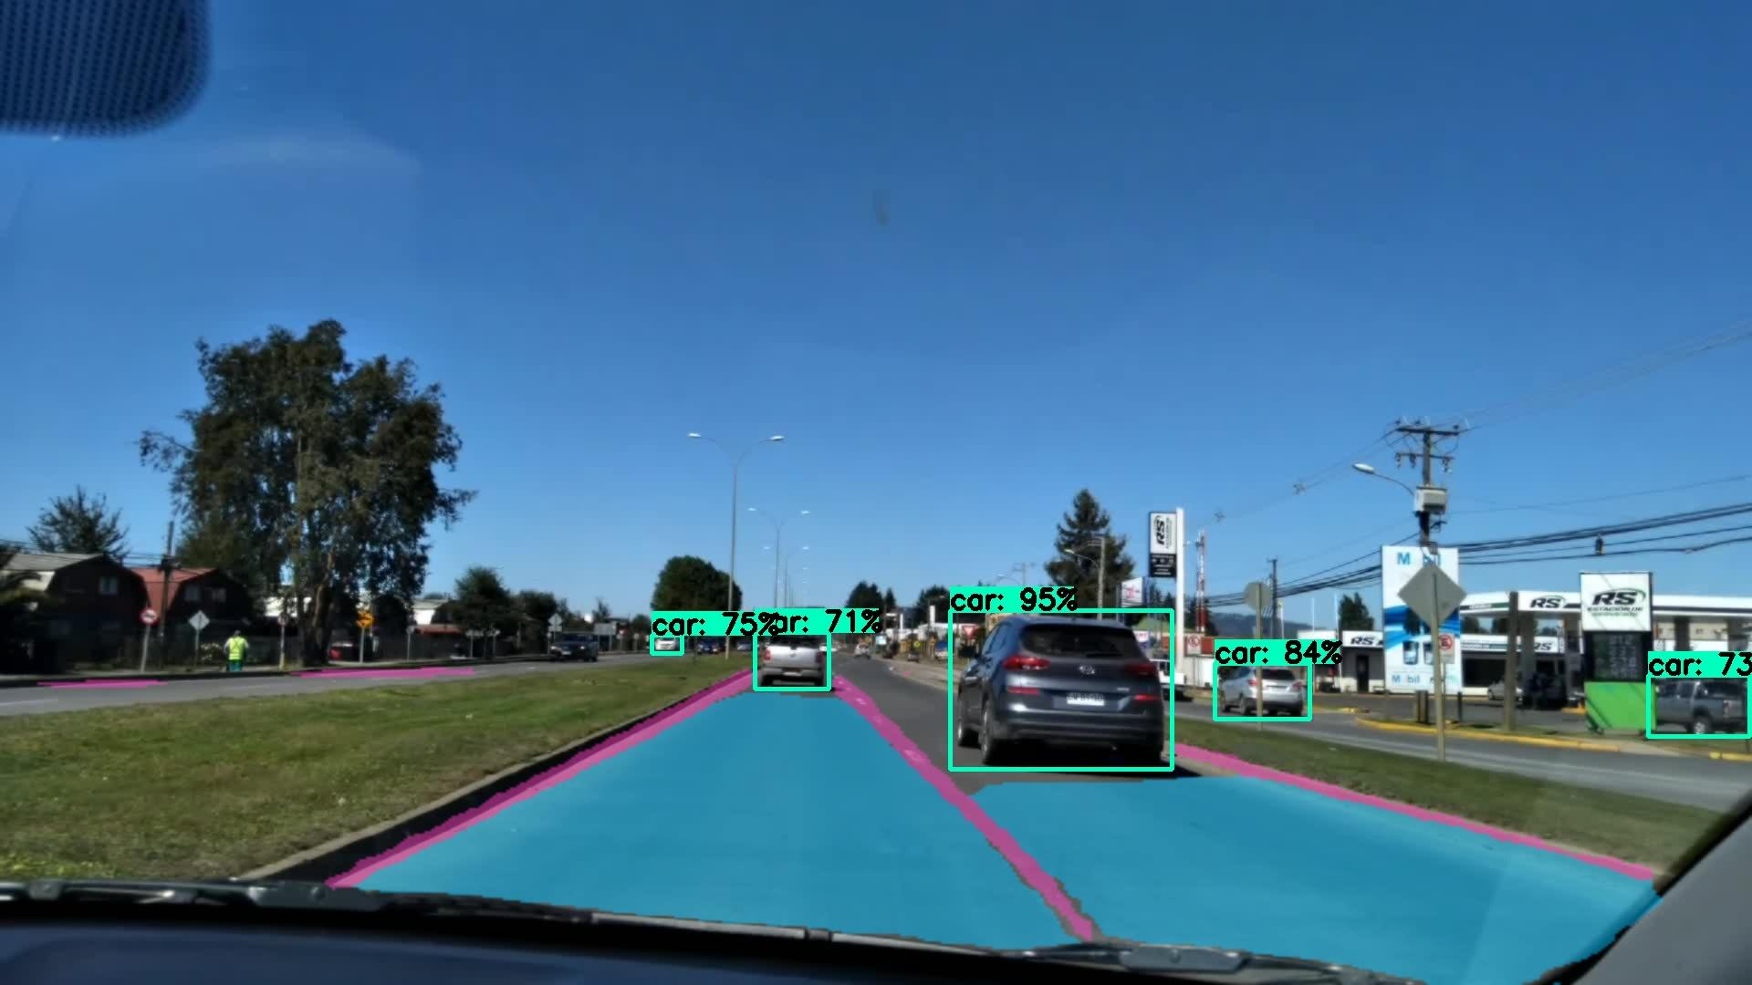
transportation
Computer Vision detects vehicles and pedestrians on roads.
It identifies traffic signs and road lanes.
It supports autonomous and driver-assistance systems.
It helps monitor traffic and detect accidents.
Computer Vision enables automated surveillance and security monitoring.

Slide 5
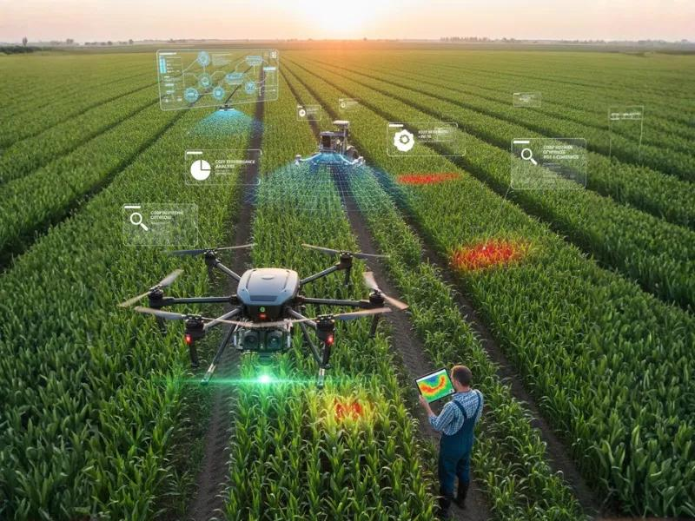
Manufacturing & Agriculture
Computer Vision is used for automated quality inspection.
It detects scratches, cracks and defects in manufactured products.
Cameras can inspect products continuously on production lines.
Robots use Computer Vision to identify and handle objects.
In agriculture, cameras and drones monitor crop health.
Computer Vision can identify weeds, pests and plant diseases.

Slide 6
Future of Computer Vision
More intelligent autonomous vehicles and robots.
AI-powered medical diagnosis and monitoring.
Smart cities with intelligent traffic management.
Advanced surveillance and safety systems.
Greater integration of Computer Vision with Deep Learning and Generative AI.
Conclusion: Computer Vision is transforming the way machines interact with and understand the real world.

